Slide 1
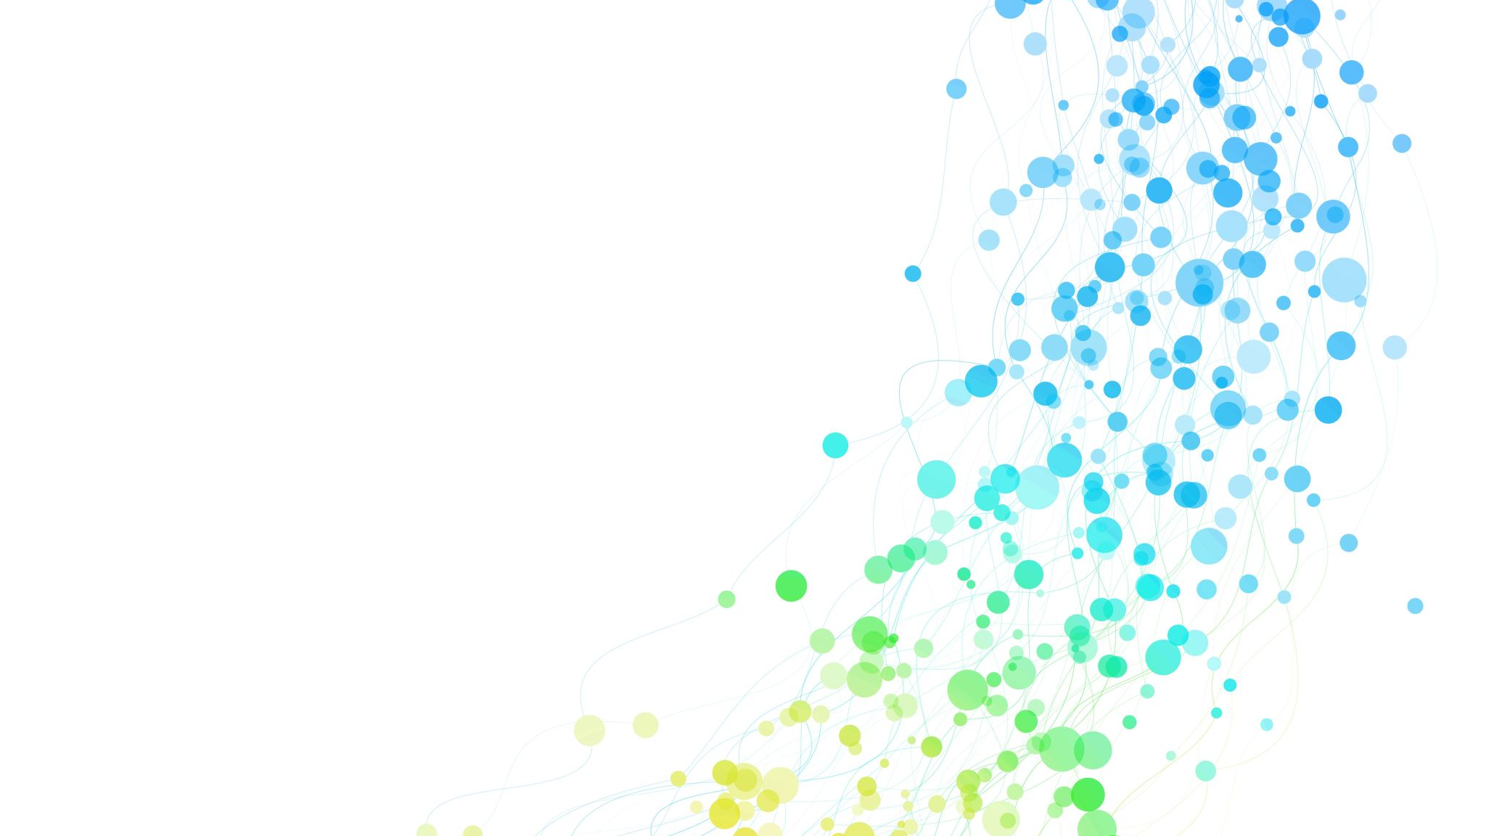
3D Graphics Project
Subject : Making a volcano Hurte Maëlig | Karlotta Kilias | Remy Julien

Slide 2
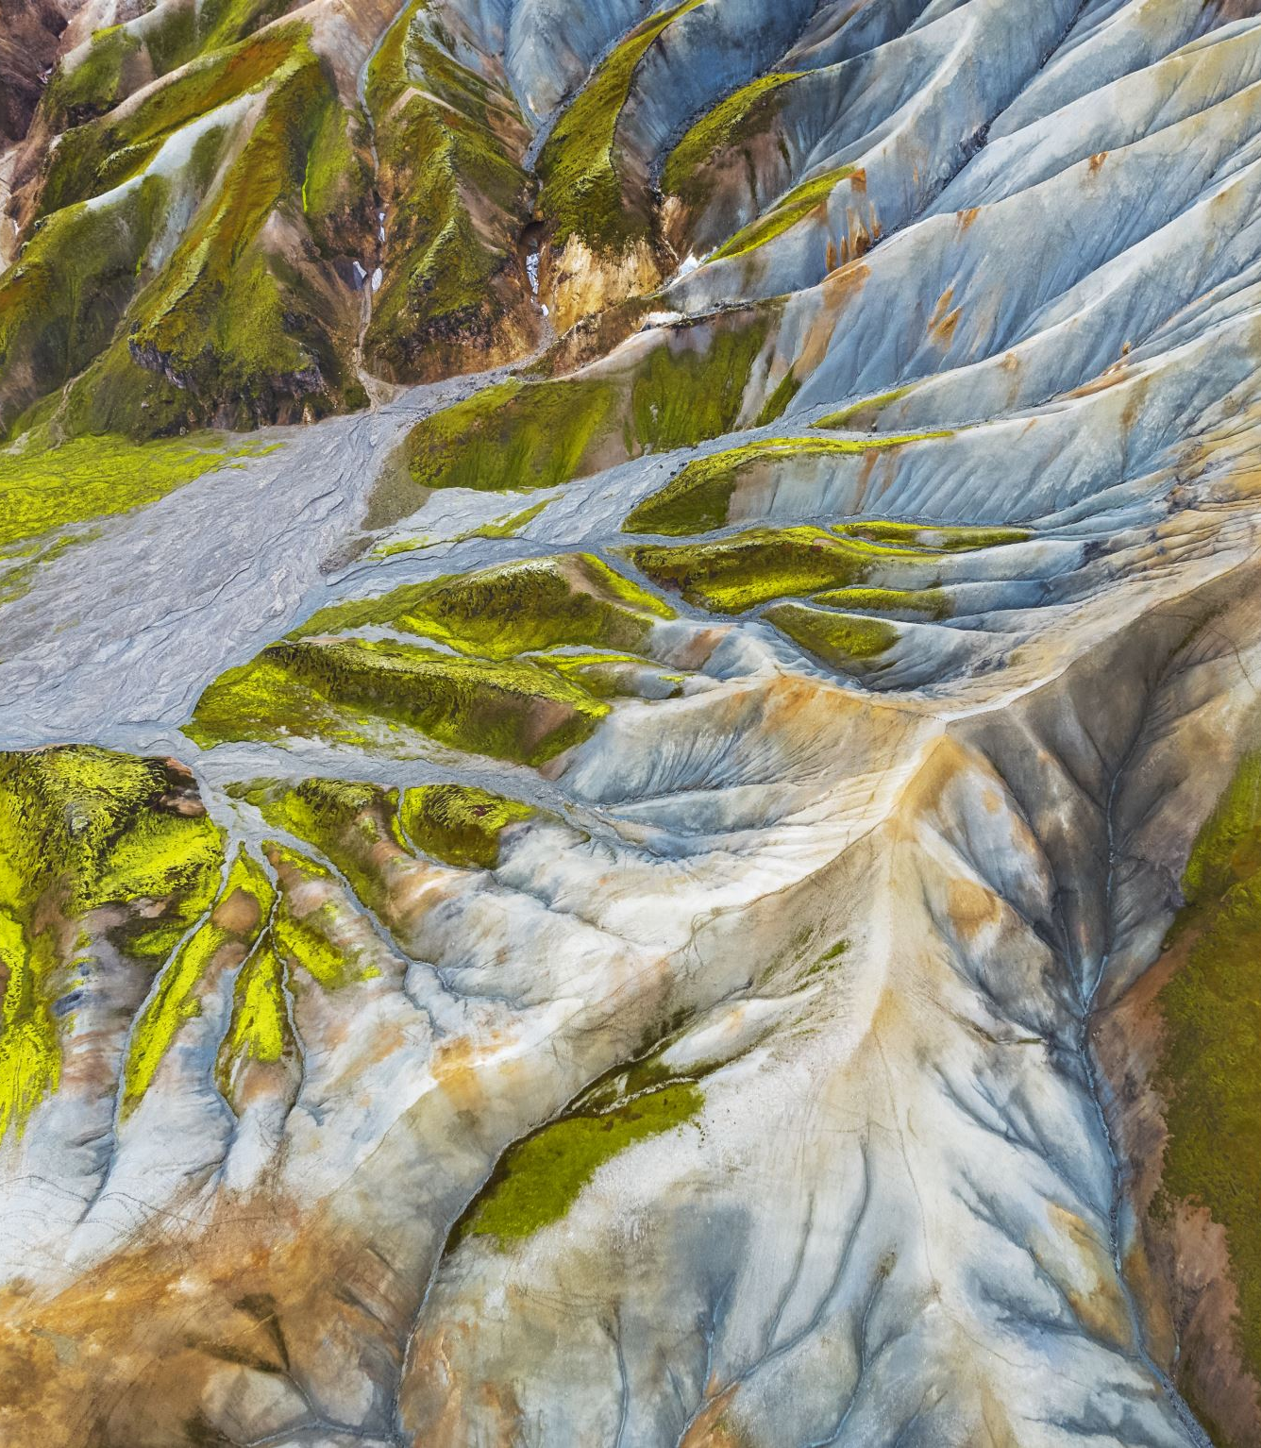
Part I : The Island
The global volcano shape was built using gaussian functions
Using perlin noise we then made the terrain much more realistic
Finally we added a texture to the terrain to give a better final result

Slide 3
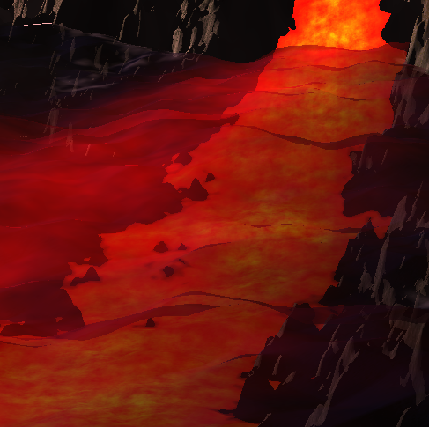
Part II : The lava
The lava is generated using perlin noise aswell
We made a glowy effect when the lava is underwater and there are lava projections on top of the volcano
It was made so that it gets darker when closer to terrain

Slide 4
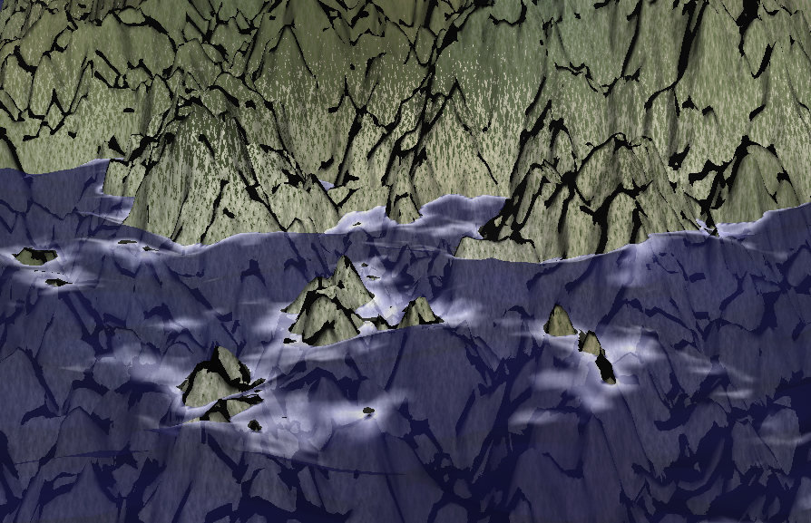
Part III : The water
The water is made using a transluscent plane on which we apply perlin noise and a normal map to give the effects we have.
We also added some white edges when it gets closer to the terrain
We added highlights on the water depending on the water level

Slide 5
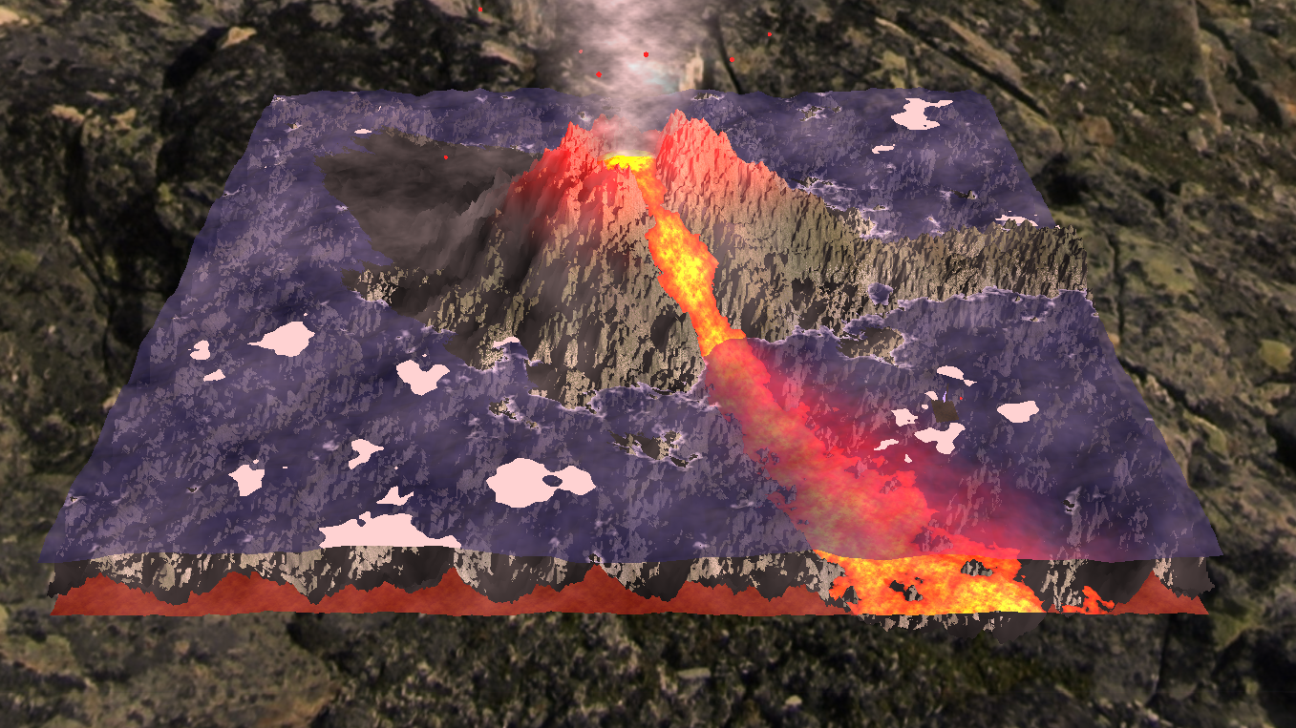
Part IV : The lighting
The global light is made using a Phong model
We use RayMarching techniques to obtain the shadows of the Volcano

Slide 6

Part V : Fog and smoke
The volcano is surrounded by fog which gives a nice effect especially when the camera is higher
The smoke on top of the volcano is made using a billboard on which we display perlin noise to represent smoke
The fog intensity can be controlled by pressing a key

Slide 7
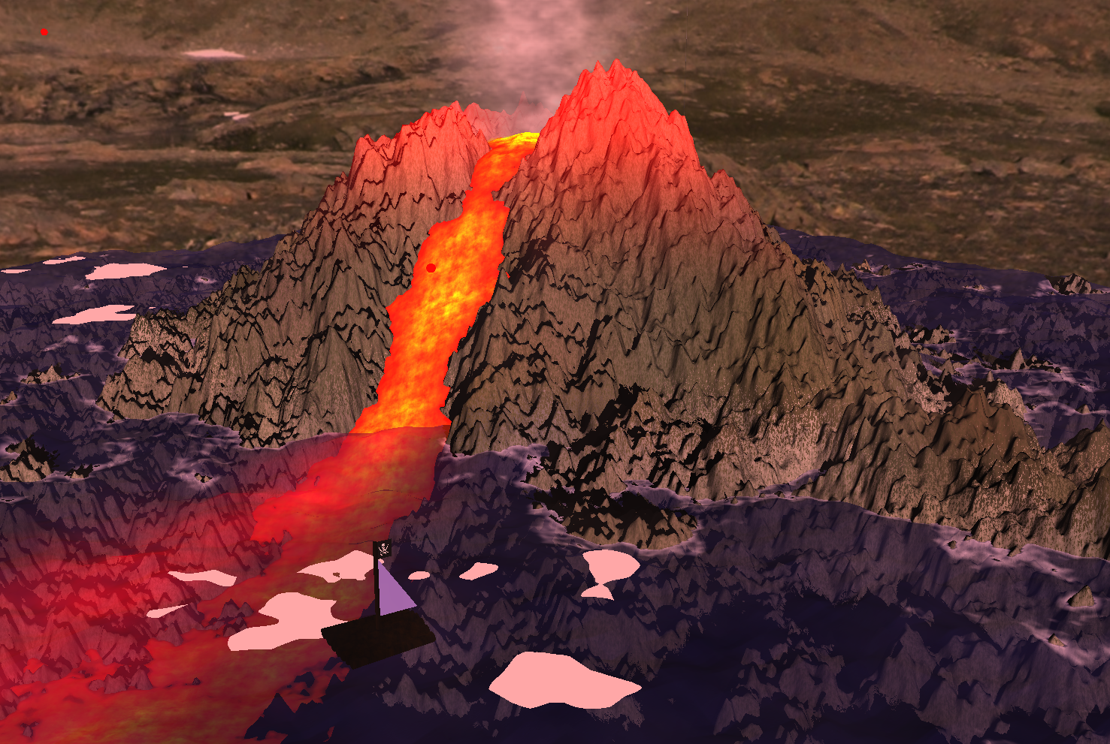
Part VI : Props
We built a pirate raft using cylinders as logs which move along the waves
And for some reasons there is a (very poorly drawn) cactus generator

